Slide 1

FFM: Flood Forecasting Model Using
Federated Learning
Team Members
1. B Murari (2273A39067)
2. K Veera Hari Tharun (2373A39L02)
3. A Bhanu Shankar (2273A39124)
4. P Teja Vardhan(2273A39112)
Project Guide
Mr. Ch. Chandra Sekar
( Assistant Professor)

Slide 2
CONTENT
ABSTRACT
OBJECTIVES
INTRODUCTION
EXISTING SYSTEM
EXISTING SYSTEM DRAWBACKS
PROPOSED SYSTEM
MERITS OF PROPOSED SYSTEM
SYSTEM ARCHITECTURE
SYSTEM REQUIREMENTS

Slide 3
ABSTRACT
Severe damage to life, agriculture, property, and economy.
Faces challenges in data privacy and centralized data sharing.
Proposed a federated learning for flood forecasting .
Data remains local → ensures privacy, security, and reduced network latency.
Model integrates client stations without sharing raw data.
Uses Feed Forward Neural Network (FFNN) at each local station.
Predicts water level and flood occurrence with 5-day lead time.

Slide 4
OBJECTIVES
To develop a machine learning-based flood forecasting model.
To implement Federated Learning for decentralized training across multiple stations.
To ensure data privacy and security by preventing raw data sharing.
To predict flood occurrence with a 5-day early warning system.
To improve flood preparedness and reduce damage to life and property.

Slide 5
INTRODUCTION
Most frequent and destructive natural disasters worldwide.
Accurate flood prediction is essential to minimize damage.
Traditional centralized prediction models face challenges like data privacy, security, and high communication cost.
Enables collaborative model training without sharing raw data.
This project proposes a flood forecasting model using federated learning with local feed-forward neural networks for early flood detection.

Slide 6
EXISTING SYSTEM
Mainly rely on centralized machine learning and traditional statistical models.
Large amounts of hydrological and meteorological data are collected from different locations and sent to a central server for training and prediction.
These methods can predict floods to some extent
They face major issues related to data privacy, security, network latency, and limited scalability.
The centralized nature also makes them vulnerable to data leakage and communication delays.

Slide 7
DISADVANTAGES
Data privacy and security risks due to centralized data storage
High network latency because large datasets are transferred
Limited scalability with increasing data sources
High computational and communication cost

Slide 8
PROPOSED SYSTEM
Flood Forecasting Model (FFM) based on Federated Learning combined with a Feed Forward Neural Network (FFNN).
Data remains at local client stations, where local models are trained using regional data.
Only the trained models (not raw data) are shared with a central server for aggregation.
Ensures privacy, reduces network overhead, improves prediction accuracy .
Predict floods up to five days in advance and generate early warnings.

Slide 9
ADVANTAGES
Preserves data privacy by keeping data at local stations
Reduced network traffic and communication overhead
Better prediction accuracy using federated learning and FFNN
Scalable and suitable for multiple regions

Slide 10
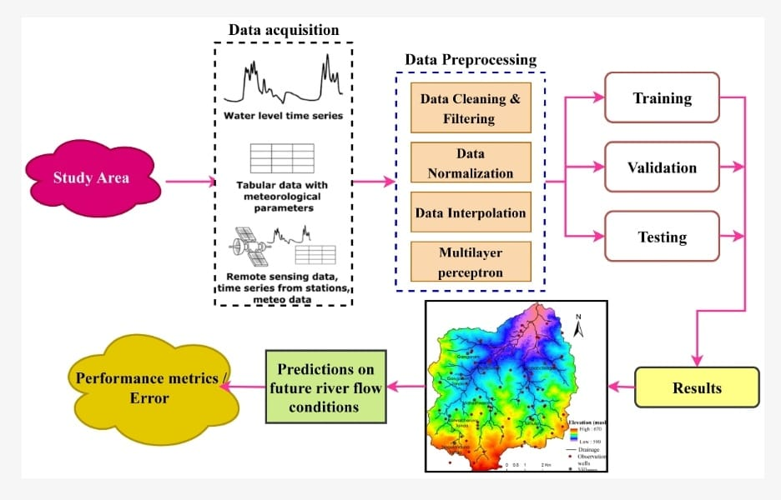
SYSTEM ARCHITECTURE

Slide 11
SYSTEM ARCHITECTURE
DECENTRALIZED LOCAL TRAINING NODES
MULTI – MODEL INPUT INTEGRATION
MODEL PARAMETER EXCHANGE
CENTRAL AGGREGATION SERVER
TEMPORAL AND SPATIAL MODEL ARCHITECTURES

Slide 12
MINIMAL SYSTEM REQUIREMENTS
HARDWARE REQUIREMENTS:
➢Processor - Pentium / Intel core
➢RAM - 4 GB (min)
➢Hard Disk - 64 GB
SOFTWARE REQUIREMENTS:
Operating system : Windows.
Coding Language : Python.
Data Base : MySQL.

